Slide 1

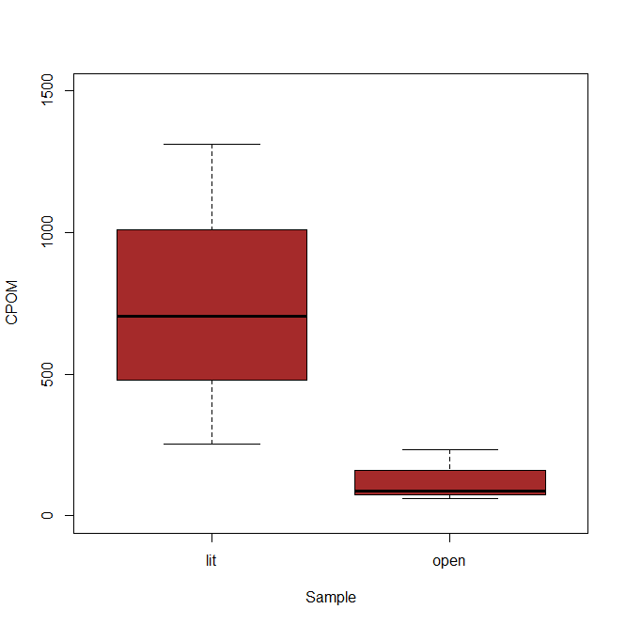
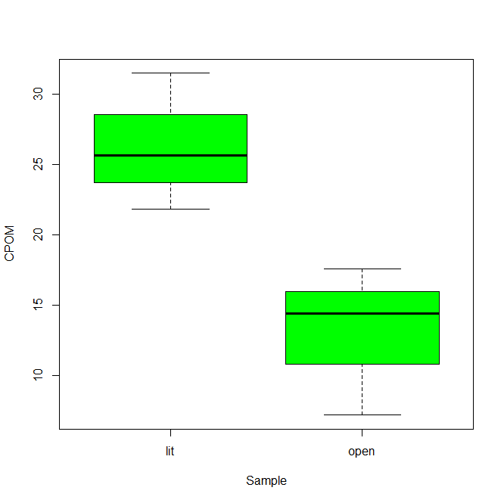
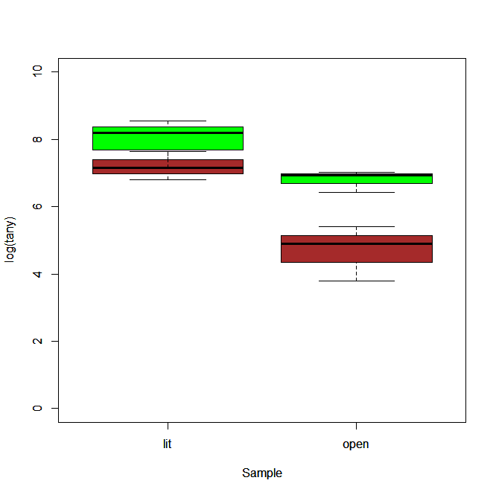
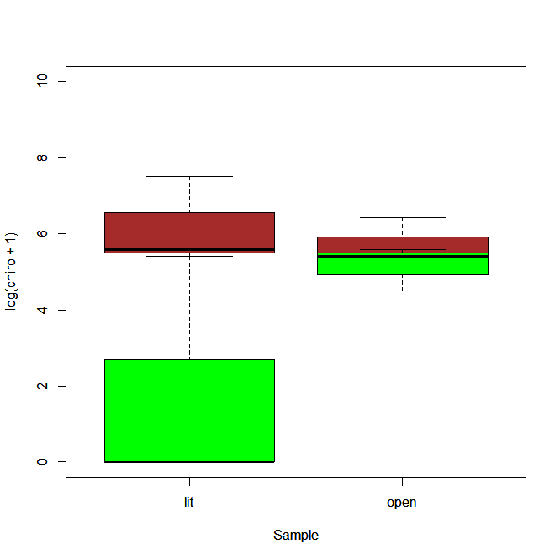
Biodiversity and Biogeochemical Cycles of Local Waterways
Carly Martin, Leanna Tacik, and Dr. Kenneth Fortino
Longwood University
Department of Biological and Environmental Sciences
Background
Results
Discussion
Ecosystems are changing at high rates due to climate, biogeochemical cycles, changes in land use, and reductions in biodiversity ¹. This research aims to identify and compare the biodiversity and biogeochemical cycles for two different bodies of water. Biodiversity is the variation of life forms within the earth including biomes, ecosystems, and species. Biodiversity is a very important aspect of life and ecosystem productivity. It has been shown by numerous studies that biodiversity can increase ecosystem productivity ².
The goal of this research was to compare the biodiversity and biogeochemical cycles of Wilke’s Lake (WL) and Lancer Park Pond (LPP). Both sites had open and littoral locations collected from them. The WL samples were taken on February 20 2013. The samples were collected from the east of the island roughly halfway between the north and south shore of the lake. The collection took place approximately 20 meters from the south shore. The LPP samples were taken on March 20 2013. These samples were collected in the middle of the pond and in the southwest corner of the pond approximately 1 meter from the south shore.
The goal of the research for me was to bring what I learned from this experience to my future classroom. Students are expected to develop research abilities, asking questions, making a hypothesis, designing and carrying out experiments, collecting data, and connecting real-world problems with the scientific world ³.
Coarse Particulate Matter found in the Littoral and Open locations at Wilke’s Lake
Coarse Particulate Matter found in the Littoral and Open Locations at Lancer Park Pond
Figure 1 shows the comparison between the CPOM found in the littoral and open locations at WL.
Figure 2 shows the comparison between the CPOM found in the littoral and open locations at LPP.
The Abundance of Tanypodinae in Wilke’s Lake and Lancer Park Pond
Graph title
Methods
  Three replica samples were collected with an Ekman and then washed through a 250µl mesh in the field and presented in 70% ethanol.
  The samples were taken back to the lab and washed through a 1 mm mesh sieve to separate the coarse particulate matter (CPOM) from the fine particulate matter (FPOM). The CPOM was placed in a one liter bottle.
  The CPOM was washed with water and then placed in pre-weighted weigh boats or brown paper bags depending on the amount. The CPOM was then dried in a Thermo Scientific drying oven at 50 º C.
  The FPOM was picked through in order to find any macro-invertebrates. The macro-invertebrates were placed in scintillation vials and stored in ethanol.
  The macro-invertebrates were then identified by family.
  In order to find the amount of organic matter (OM), the sediment was homogenized and a pre-weighed scintillation vial was dipped into the sediment before it was washed. The sediment OM was dried at 50 º C.
Acknowledgements
I
Figure 3 shows the comparison of tanypodinae in Wilke’s Lake and Lancer Park Pond. Wilke’s Lake is represented in green and Lancer Park Pond is represented in brown.
References
Kominoski, J., Rosemond, A. (2012). Conservation from the bottom up: Forecasting effects of global change on dynamics of organic matter and management needs for river networks. Freshwater Science, 31(1): 51-68.
Allen, D., Vaughn, C., Kelly, J., Cooper, J., & Engel, M. (2012). Bottom-up biodiversity effects increase resource subsidy flux between ecosystems. Ecology, 93(10), 2165-2174.
Heck, A. (2009). Bringing Reality into the Classroom. Teaching Mathematics And Its Applications: An International Journal Of The IMA, 28(4), 164-179

